Slide 1


SAP UI5 & FIORI with OData TRAINING
Anubhav Oberoy & Nishan Nainsukha
Day – 16

Slide 2

Agenda – Day 16
Implementing the delete and update method
Function Import
Exercise on Entityset
Association

Slide 3
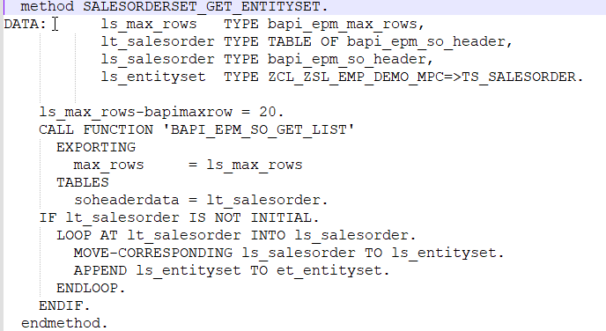
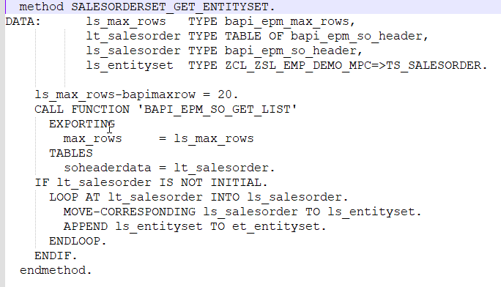
Implementing the Order header and Order Item Sets
Create the new entity set with name –
SalesOrder
OrderItem
Implement the GetEntity and GetEntitySet for both entity set

Slide 4
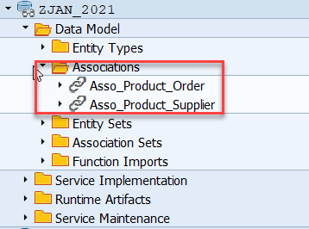
Association
Associations are relationship Between entities.
At database level we have foreign key relationship and same is reflected at odata level.
Once a association is created only then we can create navigation property.
Product
Supplier
1 relation 1
nav
Sales Order Header
Sales Order Items
1 relation n
nav

Slide 5
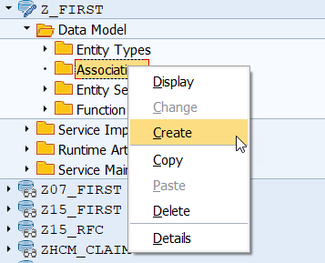
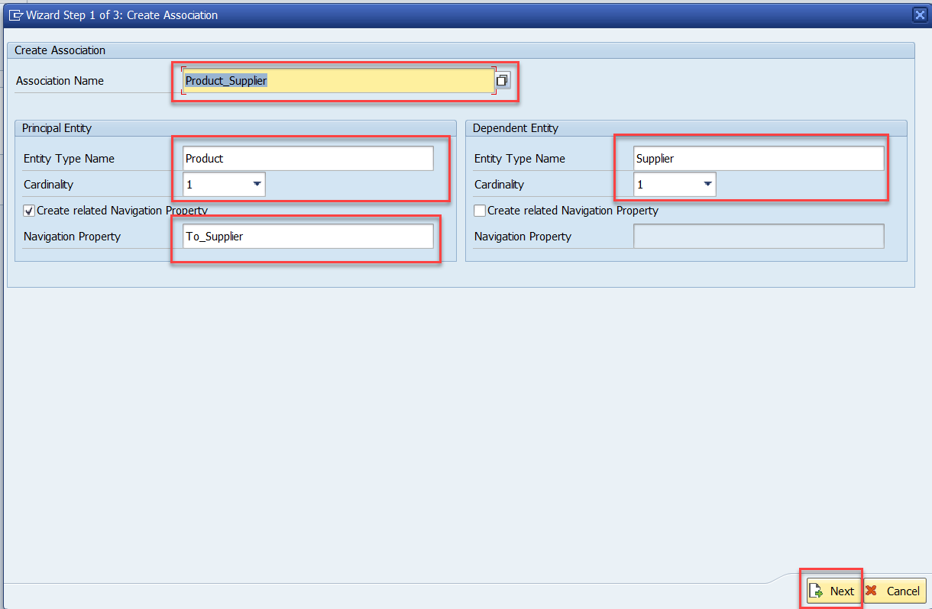
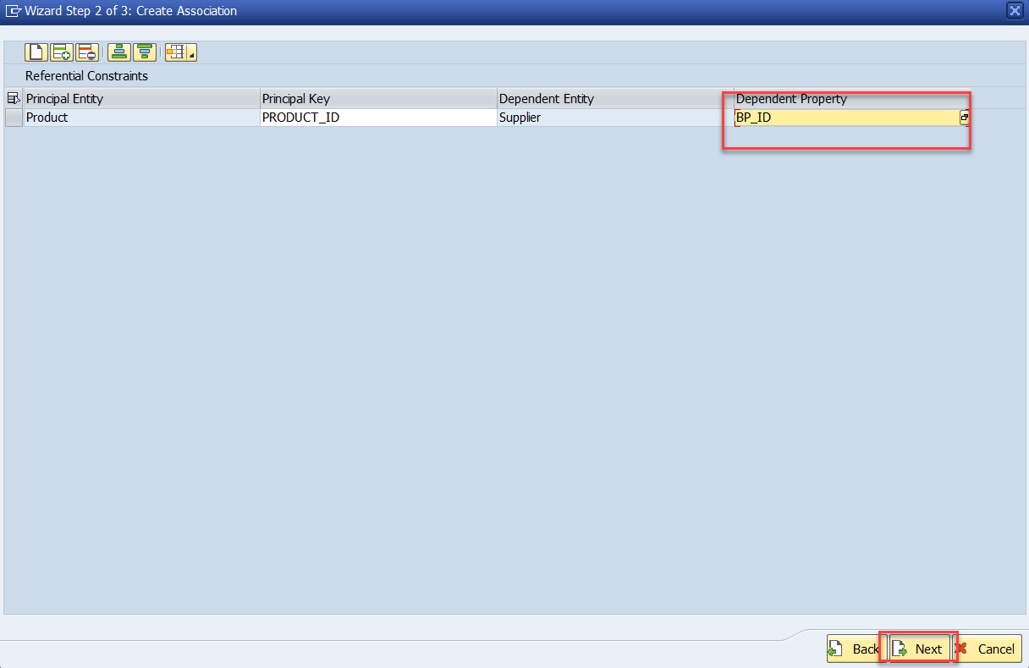
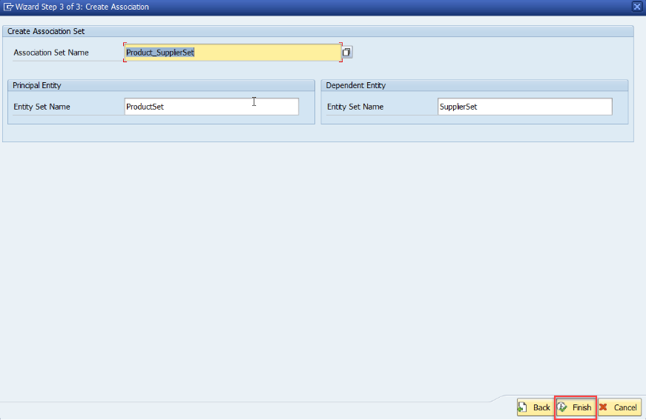
Association (1:1)
Step:1 Right Click on Association and click on create

Slide 6
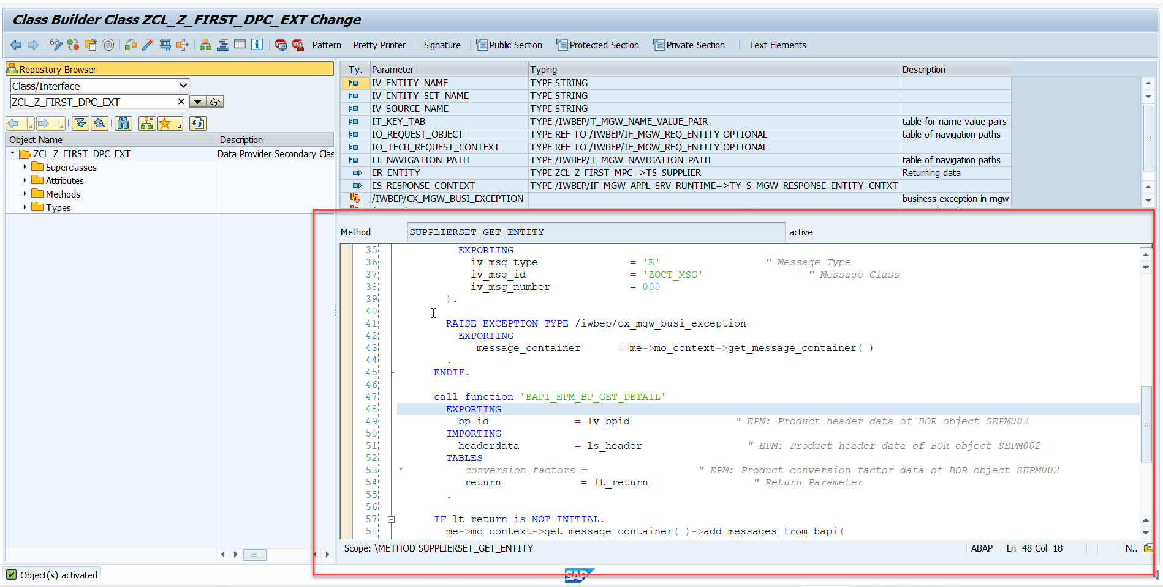
Association (1:1)
Step2: Go to DPC extension and redefine the method for supplierSet GetEntity

Slide 7

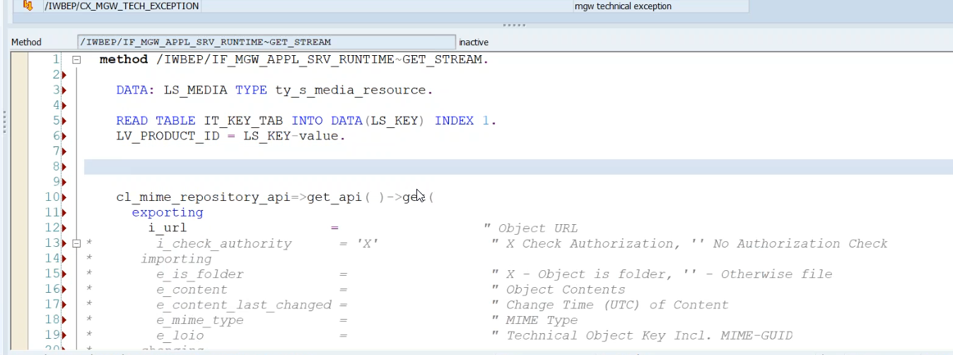
Image Processing
In ABAP all images are store in MIME Repository.
to see MIME Repository - go to se80 > utilities > settings > MIME Repository
to add Image in Odata
Step1: Go to service > entity Type > Product > select the media check box
Step2: Now add two new property to Product Set
- Product_pic_url
- MIME_TYPE
Step3: Go To MPC Extension Class and redefine the DEFINE method(for code ClickHere)
Step4: Go to DPC Extension class and redefine the Method Get_Stream (for code ClickHere)

Slide 8

End of Day 16

Slide 9

Questions

Slide 10

Anubhav Oberoy

Slide 11


We’re committed to empower you to be
Most Desirable Resource
through powerful training solutions.
We build the workforce of the future.
250+
Corporate Clients
30,000+
Learners Trained
25000+
Learners Placed
FREE WEBINARS
Sign up for free webinars with industry experts every fortnight!
Enroll Now!
Contact us today!
https://anubhavtrainings.com/

Slide 12




More from AnubhavTrainings.com

